Slide 1
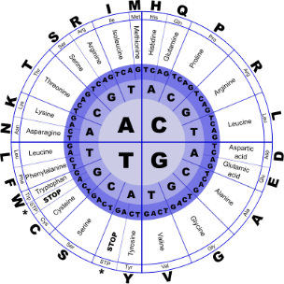
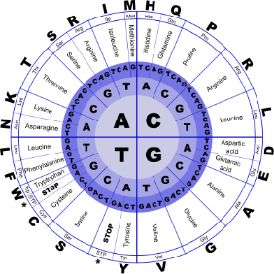


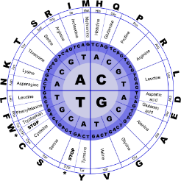
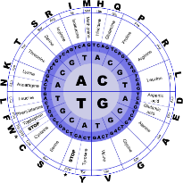
Fundamentals of Programming II
Functions

Slide 2
Modular Programming
Modular programming: breaking a program up into smaller, manageable functions or modules. Supports the divide-and-conquer approach to solving a problem.
Function: a collection of statements to perform a specific task
Motivation for modular programming
Simplifies the process of writing programs
Improves maintainability of programs
6-2

Slide 3
Defining and Calling Functions
Function call: a statement that causes a function to execute
Function definition: the statements that make up a function
6-3

Slide 4
Function Definition
Definition includes
name: name of the function. Function names follow same rules as variable names
parameter list: variables that hold the values passed to the function
body: statements that perform the function’s task
return type: data type of the value the function returns to the part of the program that called it
6-4

Slide 5
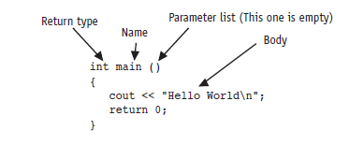
Function Definition
6-5

Slide 6
Function Header
The function header consists of
the function return type
the function name
the function parameter list
Example:
int main()
Note: no ; at the end of the header
6-6

Slide 7
Function Return Type
If a function returns a value, the type of the value must be indicated
int main()
If a function does not return a value, its return type is void
void printHeading()
{
cout << "\tMonthly Sales\n";
}
6-7

Slide 8
Calling a Function
To call a function, use the function name followed by () and ;
printHeading();
When a function is called, the program executes the body of the function
After the function terminates, execution resumes in the calling module at the point of call
6-8

Slide 9
Calling a Function
main is automatically called when the program starts
main can call any number of functions
Functions can call other functions
6-9

Slide 10
Function Prototypes
The compiler must know the following about a function before it is called
name
return type
number of parameters
data type of each parameter
6-10

Slide 11
Function Prototypes
Ways to notify the compiler about a function before a call to the function:
Place function definition before calling function’s definition
Use a function prototype (similar to the heading of the function
Heading: void printHeading()
Prototype: void printHeading();
Function prototype is also called a function declaration
6-11

Slide 12
Prototype Notes
Place prototypes near top of program
Program must include either prototype or full function definition before any call to the function, otherwise a compiler error occurs
When using prototypes, function definitions can be placed in any order in the source file. Traditionally, main is placed first.
6-12

Slide 13
Sending Data into a Function
Can pass values into a function at time of call
c = sqrt(a*a + b*b);
Values passed to function are arguments
Variables in function that hold values passed as arguments are parameters
Alternate names:
argument: actual argument, actual parameter
parameter: formal argument, formal parameter
6-13

Slide 14
Parameters, Prototypes, and Function Headings
For each function argument,
the prototype must include the data type of each parameter in its ()
void evenOrOdd(int); //prototype
the heading must include a declaration, with variable type and name, for each parameter in its ()
void evenOrOdd(int num) //heading
The function call for the above function would look like this: evenOrOdd(val); //call
Note: no data type on argument in call
6-14

Slide 15
Function Call Notes
Value of argument is copied into parameter when the function is called
Function can have > 1 parameter
There must be a data type listed in the prototype () and an argument declaration in the function heading () for each parameter
Arguments will be promoted/demoted as necessary to match parameters. Be careful!
6-15

Slide 16
Calling Functions with Multiple Arguments
When calling a function with multiple arguments
the number of arguments in the call must match the function prototype and definition
the first argument will be copied into the first parameter, the second argument into the second parameter, etc.
6-16

Slide 17
Calling Functions with Multiple Arguments Illustration
displayData(height, weight); // call
void displayData(int h, int w)// heading
{
cout << "Height = " << h << endl;
cout << "Weight = " << w << endl;
}
6-17

Slide 18
Passing Data by Value
Pass by value: when an argument is passed to a function, a copy of its value is placed in the parameter
The function cannot access the original argument
Changes to the parameter in the function do not affect the value of the argument in the calling function
6-18

Slide 19
The return Statement
Used to end execution of a function
Can be placed anywhere in a function
Statements that follow the return statement will not be executed
Can be used to prevent abnormal termination of program
Without a return statement, the function ends at its last }
6-19

Slide 20
Passing Data to Parameters by Value
Example: int val = 5;
evenOrOdd(val);
evenOrOdd can change variable num, but it will have no effect on variable val
val
num
5
5
argument in
calling function
parameter in
evenOrOdd function
6-20

Slide 21
Returning a Value from a Function
return statement can be used to return a value from the function to the module that made the function call
Prototype and definition must indicate data type of return value (not void)
Calling function should use return value, e.g.,
assign it to a variable
send it to cout
use it in an arithmetic computation
use it in a relational expression
6-21

Slide 22
Returning a Value – the return Statement
Format: return expression;
expression may be a variable, a literal value, or an expression.
expression should be of the same data type as the declared return type of the function (will be converted if not)
6-22

Slide 23
Returning a Boolean Value
Function can return true or false
Declare the return type in the function prototype and heading as bool
The function body must contain return statement(s) that return true or false
The calling function can use the return value in a relational expression
6-23

Slide 24
Boolean return Example
bool isValid(int); // prototype
bool isValid(int val) // heading
{
int min = 0, max = 100;
if (val >= min && val <= max)
return true;
else
return false;
}
if (isValid(score)) // call
…
6-24

Slide 25
Using Functions in a Menu-Driven Program
Functions can be used
to implement user choices from menu
to implement general-purpose tasks
Higher-level functions can call general-purpose functions
This minimizes the total number of functions and speeds program development time
6-25

Slide 26
Local and Global Variables
local variable: defined within a function or block; accessible only within the function or block
Other functions and blocks can define variables with the same name
When a function is called, local variables in the calling function are not accessible from within the called function
6-26

Slide 27
Local Variable Lifetime
A local variable only exists while its defining function is executing
Local variables are destroyed when the function terminates
Data cannot be retained in local variables between calls to the function in which they are defined
6-27

Slide 28
Local and Global Variables
global variable: a variable defined outside all functions; it is accessible to all functions within its scope
Easy way to share large amounts of data between functions
Scope of a global variable is from its point of definition to the program end
Use sparingly
6-28

Slide 29
Initializing Local and Global Variables
Local variables must be initialized by the programmer
Global variables are initialized to 0 (numeric) or NULL (character) when the variable is defined. These can be overridden with explicit initial values.
6-29

Slide 30
Global Variables – Why Use Sparingly?
Global variables make:
Programs that are difficult to debug
Functions that cannot easily be re-used in other programs
Programs that are hard to understand
6-30

Slide 31
Global Constants
A global constant is a named constant that can be used by every function in a program
It is useful if there are unchanging values that are used throughout the program
They are safer to use than global variables, since the value of a constant cannot be modified during program execution
6-31

Slide 32
Local and Global Variable Names
Local variables can have same names as global variables
When a function contains a local variable that has the same name as a global variable, the global variable is unavailable from within the function. The local definition "hides" or "shadows" the global definition.
6-32

Slide 33
Using Reference Variables as Parameters
Mechanism that allows a function to work with the original argument from the function call, not a copy of the argument
Allows the function to modify values stored in the calling environment
Provides a way for the function to ‘return’ more than 1 value
6-33

Slide 34
Reference Variables
A reference variable is an alias for another variable
It is defined with an ampersand (&) in the prototype and in the header
void getDimensions(int&, int&);
Changes to a reference variable are made to the variable it refers to
Use reference variables to implement passing parameters by reference
6-34

Slide 35
Pass by Reference Example
void squareIt(int &); //prototype
void squareIt(int &num)
{
num *= num;
}
int localVar = 5;
squareIt(localVar); // localVar now
// contains 25
6-35

Slide 36
Reference Variable Notes
Each reference parameter must contain &
Argument passed to reference parameter must be a variable. It cannot be an expression or a constant.
Use only when appropriate, such as when the function must input or change the value of the argument passed to it
Files (i.e., file stream objects) should be passed by reference
6-36

